Slide 1
Ways to build resilience

Slide 2

Positive self-talk
I can
overcome challenges
I am strong
I can do this
I am capable
I can do this
I will keep trying
– it’s ok if I fail sometimes or find things difficult
Things will
get better
I am resilient
Notes:
Have you thought about the way you talk to yourself? Positive self-talk is vital to creating a happier life and can also help in developing resilience. People tend to be their own worst critic, but this just wears you down and decreases your self-confidence and resilience to things.
Talk to yourself as it you were your own best friend! When you start talking to yourself like you would talk to someone you love and respect your resilience and positivity will explode!
Being supportive and speaking kindly to yourself will help you feel so much better overall and develop trust that you can cope with any difficult situation.
Think about things you can say to yourself that will give you comfort
Boost your self-confidence and self-esteem
Be kind to yourself and give yourself the benefit of the doubt – you are worth it!
Don’t listen to unwelcome thoughts – drowned out those self-doubts with positive affirmations and self-praise!

Slide 3
Problem-solving practice
Think of a simple imaginary problem you might face in school or on a regular day
Test yourself on how to solve it!
Break down an issue into smaller actions, to solve it ‘step-by-step’
Notes:
Thinking about ways that we can solve everyday problems we come across at school or in our daily lives can help build problem solving skills and make us more adaptable (this means we can be flexible, we can change our thinking and approach as a situation rises – we don’t have one fixed way of going about things).
By figuring out ways to solve issues we can build our resilience and confidence over a period of time.
Set achievable goals – use smaller steps and break down a problem into smaller chunks. Each time we solve one of these ‘steps’ it boosts our confidence and gets us closer to solving the whole problem too!

Slide 4

Celebrate you!
Write a letter to yourself, telling yourself
about your strengths, qualities and reminding
yourself of when things have gone well
Talk about good things you have done, your
achievements and good time you have experienced
Draw a picture of yourself and all the good things about you!

Slide 5
Ask someone for help
Have a simple chat with a friend – you don’t have to talk about your problem
Find an adult you trust and share your worries – you can come up with a plan together
Spending time with people who care about you makes you feel both feel good
Notes:
Asking someone for help and support is a great resilience skill. Recognising that you can’t always ‘go it alone’ or solve problems by yourself is a very strong character trait!
Even if it’s just a chat with a friend or a more serious conversations with a trusted adult – sharing your thoughts, ideas and even concerns is a great way to think up solutions and feel better too.
Where else can you go for support? Are there services or other places you can go for information? People to talk to?
By talking with others, we are also building our connections with other people. Being connected with other people we care about and who care for us is a good feeling.
Talking about other things can also help take our mind of our big worries, and sometimes makes them feel smaller.

Slide 6

Be active! Be creative!
Try something new – push yourself!
Get some exercise!
Take up a hobby!
Notes:
One of the best ways to develop confidence, which will also help you with building resilience, is to do things that challenge you. When you push yourself to try new things, maybe even those that are a bit intimidating to start with or that you feel you ‘can’t’ do to start with, you show yourself that you can cope even when you are out of your ‘comfort zone. It doesn’t have to be a big thing either! And think of the sense of achievement if you succeed! And if you fail – try again and this will show you are becoming more resilient!
Doing something creative (like an art or craft-based activity) can help you to feel calmer and take your mind of any problems for a while.
Getting active is a win-win too. Doing exercise will help you to feel better, and you might even feel healthier too. It’s also a good and safe distraction form any worries you might have. If you can get outside and do this too, then you can also tap into the positive of connecting with nature – this is shown to have a major benefit on our wellbeing.
Learn a new skill or take up a new hobby., This could lead to you meeting new people, having new experiences – all things that are good for you and can be lots of fun, too. You could volunteer to do something for others maybe – this will help both you and them feel good!

Slide 7
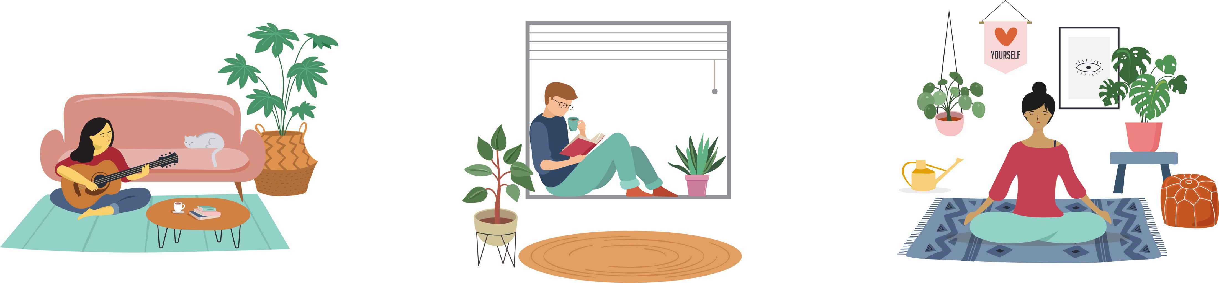
Use relaxation/mindfulness techniques
Think about all the different ways you can relax!
Notes:
Refer pupils back to the techniques that we have already worked on as part of this.
What other forms of relaxation might there be that we can tap in to?

Slide 8
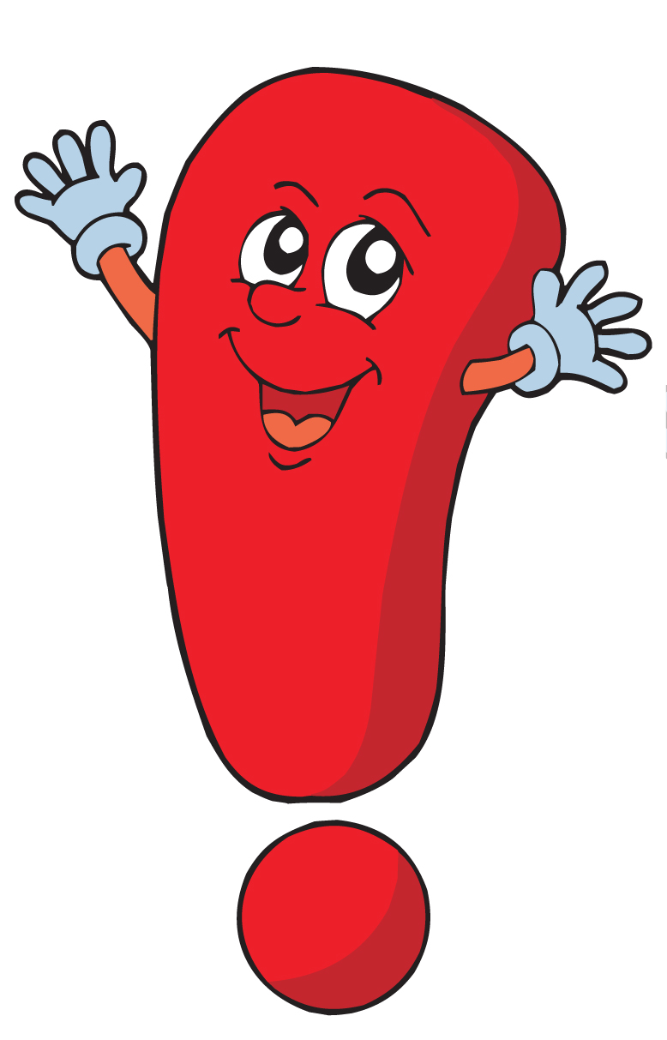
Remember this please!
If you are feeling low, or struggling to cope with certain situations, then this is normal.
It is OK to NOT BE OK!
Lots of people struggle from time to time. What is important, is knowing that problems can be sorted out if we get help soon enough
So, whether you use any of these ways of building resilience or not, it is ALWAYS important to go and speak to a trusted adult and get support.

